Slide 1

FreshCheck.AI
Harmonizing Product, Nature & Life through AI-Driven Waste Prevention
The Crisis
The Gap
40% of US food supply wasted annually
No real-time expiry tracking
Poor fridge inventory visibility
$161B+ economic loss from spoilage
Entirely manual monitoring
170M+ tons of CO₂ emissions
Our Solution
AI-powered platform predicting food expiry
Computer vision spoilage detection
Smart alerts & recommendations

Slide 2

Tech Stack
Built on enterprise-grade infrastructure with cutting-edge AI capabilities
Frontend Layer
AI/ML Engine
React.js with JavaScript core
YOLOv8 for instant food recognition
Tailwind CSS for responsive design
Google Gemini Vision API for expiry reasoning
Chart.js for real-time analytics
Deployed via Vercel CDN
OpenCV with real-time MJPEG streaming
Backend Foundation
Cloud & Integration
Django (Python) REST APIs
SQLite prototype, Postgres-ready
Vercel edge deployment
Scalable microservices architecture
Twilio API for SMS notifications
WebSockets for live inference feeds

Slide 3


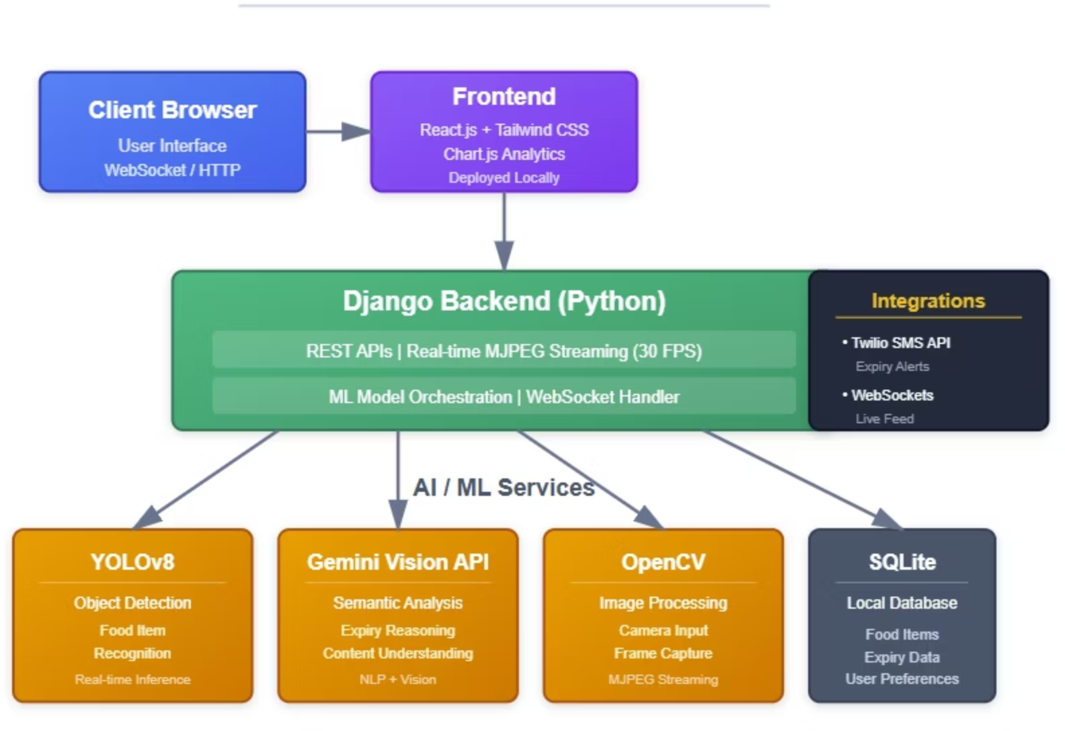



System Architecture
Capture
Real-time camera feed via OpenCV MJPEG streaming
Analyze
YOLOv8 detection + Gemini Vision semantic reasoning
Store
Django REST APIs with SQLite/Postgres backend
Alert
React dashboard + Twilio SMS for expiry warnings

Slide 4

Impact
Revolutionizing Food Management for a Sustainable Future
Sustainable Consumption
Environmental Protection
Reduces household & commercial food waste through intelligent tracking and predictive alerts.
Minimizes greenhouse gas emissions by preventing food waste disposal and unnecessary transportation.
Smart Living
Resource Conservation
Empowers users with AI-powered food management, automated reminders, and intelligent consumption patterns.
Preserves water, energy, and agricultural resources by preventing waste - every pound of food saved conserves the resources used to produce, process, and transport it.
FreshCheck.AI — Where technology meets sustainability to create a waste-free future

